Slide 1
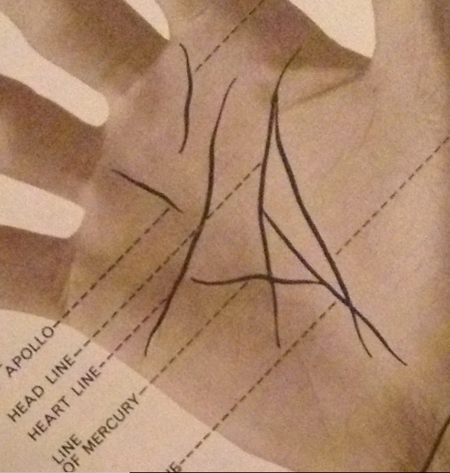
How to Read Your Palm
By Katherina
WWW.KATHERINASREADINGS.COM
PH: +61408621282

Slide 2
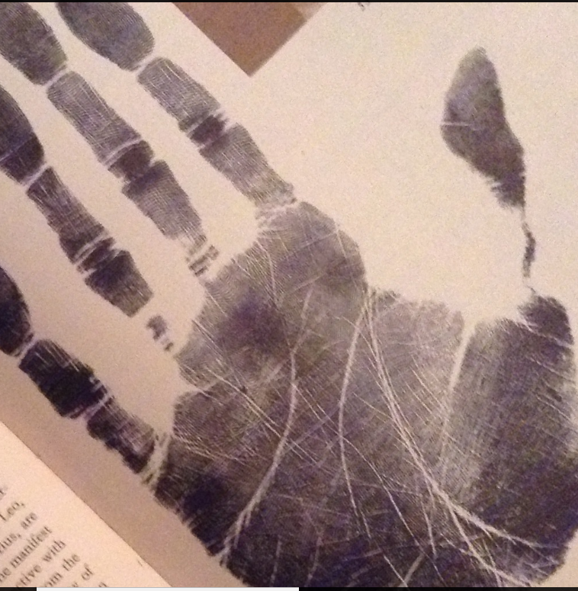
THE HAND SHAPE
Initially one must decide if the hand shape is Earth, Air, Fire Water
Earth is square palm, short fingers. Practical, supportive, mechanical.
Air is square palm, long fingers. Intellectual, Researchers Analysts Teachers
Fire is long palm short fingers. Creative, Active, Sociable
Water is long palm long fingers. Intense, Intuitive, Sensitive
Picture of Water Hand

Slide 3
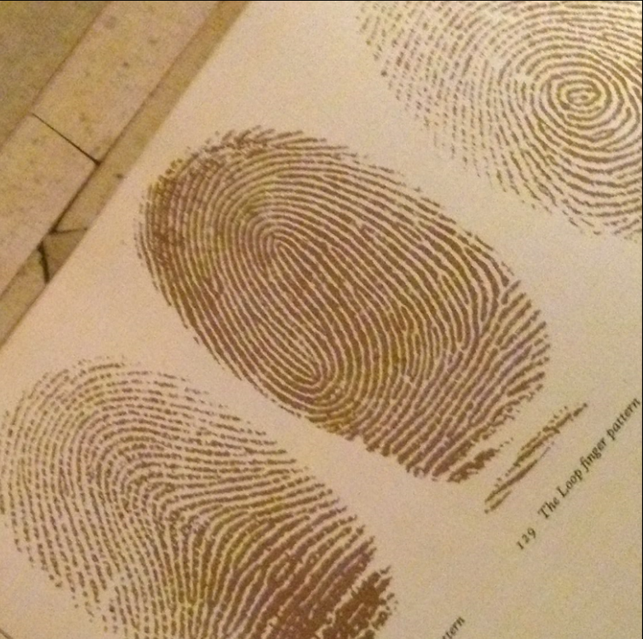
Finger Prints then provide vital clues to the personality
There are 3 main prints and
many more variations
Arches are practical and can be pragmatic
Loops are affable and diplomatic
Whorls are creative, individualistic

Slide 4
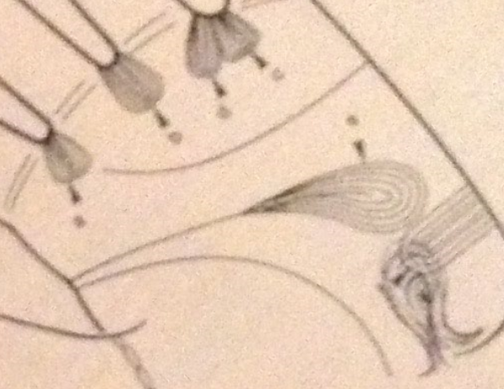
SKIN RIDGE PATTERNS
There are many different skin ridge patterns on the hand including a variety of special markings which will assist the Palmistry Analyst in defining more personality traits and special gifts associated with the Client
The markings between the fingers
1st (Jupiter) & 2nd (Saturn) is known as the Rajah Loop and the individual will
be very charismatic
2nd finger (Saturn) and 3rd finger (Apollo) indicated serious application to
work and study
3rd finger (Apollo) & 4th finger (Mercury) the individual enjoys a social life
The loop at the end of the head line is one of intuition or telepathy
The loop on the edge of the Luna mount is sensing vibrations
The loop rising from the wrist is rare and said to indicate inspiration.
This picture indicates only a few.

Slide 5
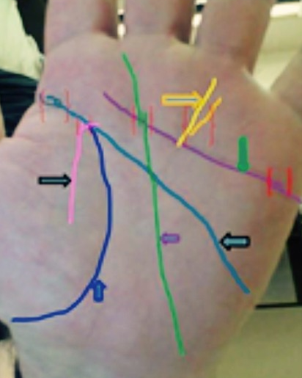
The lines indicate the Life Journey
In this example the
Life Line in dark blue indicates a strong physical energy.
An inner pink line cutting it indicates a marriage and islands with disrupted
lines above show possible childhood distress
Head Line in lighter blue is very long showing attention to detail and study
The Heart line in purple is clear cut showing steady emotional
control but is broken at one end indicating a health issue
Sun line in yellow indicates financial success with a branch line
which indicates money going out.
Fate line in green is strong dedication to career. Broken at early 50’s indicates career change with new line heading towards first finger (Jupiter) and second
Finger (Saturn) indicates personal & business satisfaction

Slide 6
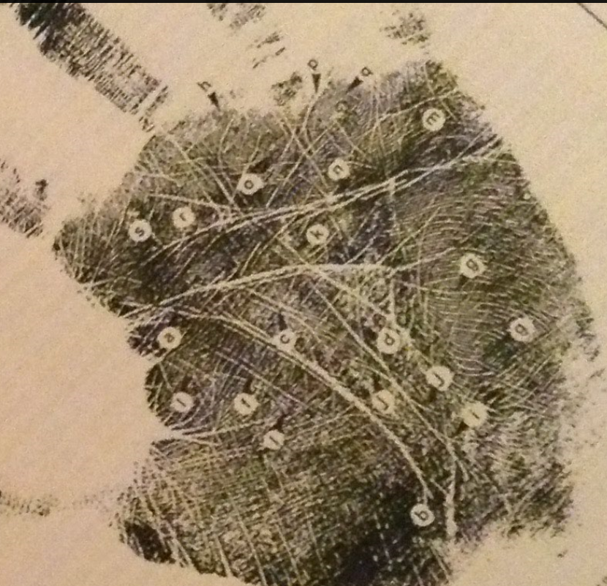
SUMMARY
There are many other lines and markings coupled with more detailed information on hand shapes, fingernails, finger shapes, thumbs and skin ridge patterns.
For a complete analysis of your hand
Career, Health, Relationships, Travel, etc.
Phone Katherina for a private consultation +61408621282
Or visit the web site
www.katherinasreadings.com
A phone consultation is also available by sending a clear photo image of your hand by email to zestylife@icloud.com

